Slide 1
Gaining Control of Cellular Traffic Accounting by Spurious TCP Retransmission
Presented by Geonha Park
Originated from Younghwan Go, Jongil Won, Denis Foo Kune*, EunYoung Jeong,Yongdae Kim, KyoungSoo Park
KAIST
University of Michigan*
Notes:
Hello, my name is Geonha Park.
From now I will present about “Gaining Control of Cellular Traffic Accounting by Spurious TCP Retransmission”
I prepared this presentation by referring to authors’ original slides.

Slide 2
Outline
Background
ISP’s accounting policy
TCP retransmission attacks
  Usage-inflation attack
  Free-riding attack
Defending attacks
Evaluation
Conclusion
Notes:
This is outline.
Before I introduce this paper, I will explain about background briefly first.
And then, I am going to describe this paper in the order.

Slide 3











Mobile Devices as Post-PCs
Smartphones & tablet PCs for daily network communications
Notes:
Today, the most of people connect to the internet with their smartphones. All of people in here also surf the internet everyday with smartphone.
Some people watch Youtube, others check their facebook, messengers or kakaotalks. Even some ones play the on-line games.

Slide 4
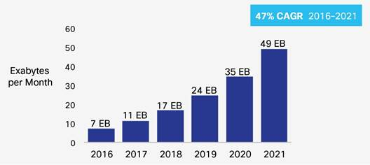
Mobile Devices as Post-PCs
Smartphones & tablet PCs for daily network communications
  Massive growth in cellular data traffic (Cisco VNI Mobile, 2017)
Notes:
This is the graph which indicates consumptions of cellular data traffic in the world.
As you can see, annual usages are rapidly increased.
In hear, CAGR means Compound Annual Growth Rate. So, every year, people use the internet about 50% more than last year with Smartphones.

Slide 5
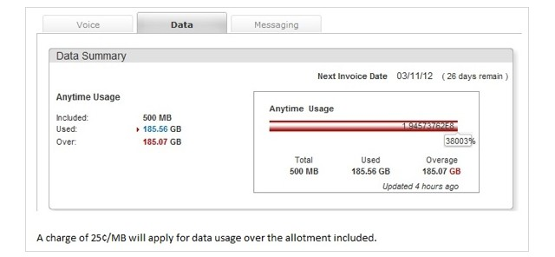

Cellular Traffic Accounting
Increase in cellular traffic bill
  Average: $71 per month (2011) –J.D. Power & Associates
  US raw mobile data price most expensive in the world(ITU, Oct, 2013)
    500MB: $85 (US), $24.1 (China), $8.8 (UK), $4.7 (Austria)
Overage fee will be
$46,267.5 !!
Cellular Network subscribers want accurate accounting!
Notes:
Let’s think about cellular network. Who provides the cellular network services? ~~Yes, Internet Service Providers, called ISP, offer the cellular internet services. Instead of providing services, they charge the fee to subscribers.
In this case, It is important to evaluate exact usages for both sides.
Especially, for customers, they are sensitive to cellular traffic accounts. Although this mobile data price is for 2013, but these days, data price still expensive.
Many subscribers have a limit of their data usage. When subscriber overuse the their data exceeding limit, they should pay a lot of the cost.
There is an example.
Therefore, Cellular Network subscribers want accurate accounting.

Slide 6



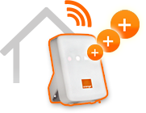



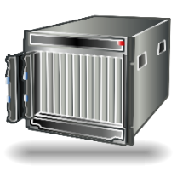



Cellular Network Overview
Global Cellular Network
4G Core Network (EPC)
SGSN
HSS
MME
IMS
Billing
Domain
PCRF
HeNB
Firewall
Internet
NAT
S-GW
P-GW
USIM
Signaling
eNodeB
SGSN : Service GPRS Support Node
HSS : Home Subscriber Server
MME : Mobility Management Entity
S-GW : Serving Gateway
P-GW : PDN Gateway
PCRF : Policy and Charging Rule Function
HeNB : Home eNodeB
EPC : Evolved Packet Core
Data Traffic
User Equipment
(phone, modem)
Data, Signaling
Notes:
This slide show the cellular network overview.
It looks quite complex, but we don’t see all elements in here.
The main point in here is that Packet data network Gateway, P-GW
This P-GW is connected to billing system, that is when a packet pass through the P-GW, you should pay the money for the packet.

Slide 7
Problem Description
There are two ways to charge a fee on the billing system
  Blind policy
    Accounts for every IP packet regardless of retransmission
    It doesn’t care about a packet is transferred to proper location.
  Selective policy
    Does not charge for retransmission packets
    The billing system doesn’t check a payload with attention.
Question:
Most of traffic is done via TCP (95%) [Woo’ 13]
Then, should ISP account for TCP retransmission?
(ISP: Internet Service Provider such as SKT, KT, AT&T, T-Mobile)
Notes:
On billing system, there are two ways to charge a fee.
One is blind policy. It accounts for every IP packet regardless of retransmission.
But since billing system is in the middle of the path, so it doesn’t consider about a packet is transferred properly.
And the other is selective policy. It does not charge for retransmission packets. But, it also has a problem. The billing system just see the sequence number of packets, so if payload is changed, ISPs doesn’t notice that.
Here, we have a single question. Most of cellular traffic is done via TCP protocol (about 95%). Then there is a question. Should ISP account for TCP retransmission?

Slide 8
TCP retransmission
TCP guarantees reliable data transfer.
  When it suspects a packet loss, it retransmit a packet.
Two major reasons for TCP retransmission
  Packet losses in the path
    Server ↔ ISP
    Within the ISP
    Client ↔ ISP
  Bufferbloating at the base stations
    Buffer has limited space
Notes:
Before answering question, let me explain about TCP retransmission for short time.
While you access and surf the internet, you might experience a packet drop. In this case, TCP retransmit the packet to guarantees reliable data transfer.
The packet drops could occur when it is transferred in the path between nodes,
And when huge traffics are gathered into one node, the packet drop could appear because buffer size is limited.

Slide 9

Cellular Provider’s Dilemma:
Charging TCP Retransmissions
What is TCP retransmission?
Subscriber vs Cellular ISP
  User’s thinking
I want to pay just for application data only!
Network condition is not my fault!
Charge volume = file size
Notes:
Returning to the question. Should ISPs account for TCP retransmission?
For user side, the answer is no.
Users think that ISPs are also responsible to keep network condition being good. They would think it is a part of service which should be offered by ISPs.

Slide 10

Cellular Provider’s Dilemma:
Charging TCP Retransmissions
Subscriber vs Cellular ISP
  ISP’s thinking
Need to update the system
Make charge for all packets!!
Retransmission =
Another IP packet
Can earn more money!
Notes:
However, for ISPs, they wouldn’t agree that.
Not only updating the whole system is difficult, but also it is a chance to earn money.

Slide 11
Contributions
Identify current TCP retransmission accounting policies of 12 cellular ISPs in the world
  Some ISPs account for retransmissions (blind), the others do not (selective)
Implement and show TCP retransmission attacks in practice
  Blind → “Usage-inflation” attack
  Selective → “Free-riding” attack
Design an accounting system that prevents “free-riding” attack
  Accurate identify all attack packets
  Works for 10 Gbps links even with a commodity desktop machine
Notes:
From now, I will explain about the paper.
First, authors investigated the current accounting policies for TCP retransmission of 12 cellular ISPs in the world. All of ISPs adopt one of the two policies, blind and selective. I will talk about investigated result on next slide.
However, both of policies have vulnerabilities, so after first section, I will describe attack methods for each policy.
At the last, I will show about new accounting system which can prevent “free-riding” attack

Slide 12
TCP Retransmission Accounting Policy
Tested 12 ISPs in 6 countries
Vulnerable to “usage-inflation” attack
Vulnerable to “free-riding” attack
Notes:
Authors tested and identified which policy ISPs use. As a result, they could figure out 9 of 12 ISPs adopt a blind policy which accounts for every IP packet regardless of retransmission. And the others apply a selective policy which dose not charge for retransmission packets.
ISPs who choose blind policy, they are vulnerable to usage-inflation attack.
And the other ISPs who use selective policy, they are vulnerable to free-riding attack

Slide 13

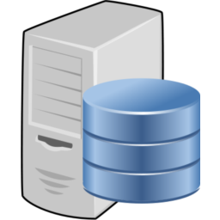
Usage-inflation Attack
Intentionally retransmit packets even there is no packet loss
  ISPs with blind accounting policy charge for all packets
Strength:
No need to compromise the client
User does not notice an attack
Retransmit packets
in background
Notes:
First attack what I am going to talk is Usage-inflation attack. This attack target to the blind accounting system.
This attack arbitrarily inflates the cellular data usage of a target subscriber by intentionally retransmitting packets in the flow even without actual packet loss.
For example, attacker send a phishing message to victim client first. If victim access the link, it is connected to malicious server. After connecting, the malicious server send retransmission packets to client in background. In this case, victim will receive a bill with huge amount of fees later.

Slide 14


Retransmit after FIN
Ignore client’s FIN/RST to prevent TCP teardown
  Utilize full bandwidth to overcharge the usage
Some ISPs allow attacks even after 4 hours!
I didn’t notice
Overcharge
Victim UE
Wired Internet
Cellular Networks
$
No!
Drop!
Packet 1
Packet 2
FIN/RST
Inflate more than 1GB in just 9 minutes!
Malicious Server
Billing System
Victim Client
Notes:
There are two ways to implement usage-inflation attack.
First method is retransmitting after FIN.
When a client has finished their business, the client send a FIN packet to server to close the connection.
However, from the result of investigation, authors figure out (that) client side continues to reply to all incoming retransmission packets after sending a FIN packet for 2~3 minutes. After that, client send RST packet to the server to stop the flow of TCP connection. In this case, some ISPs drop all retransmission packet after RST, but other ISPs keep delivering the data between client and server.
If ISPs keep delivering packets, malicious server drop the RST packet intentionally, and keep sending retransmission packets to client. For client side, since they ignore all packets after RST, so they can’t notice about that.
This situation allows attacker to inflate the usage to 1.14 GB in just 9 minutes.

Slide 15
Retransmit during Normal Transfer
ISP may block data packet retransmissions after FIN/RST
Embed retransmission packets in stream of normal packets
  Guarantee minimum goodput for interactive content
Notes:
The second usage-inflation attack is retransmitting during normal transfer.
While just before usage-inflation attack could be blocked by dropping all packets after RST, this attack can inflate data usage without any obstacles.
This attack targets a client who downloads large data for long time periods. The attacker can inflate the usage by injecting retransmission packets during normal data transfer in background. To avoid the detection, attacker should guarantee minimum goodput. This graph shows the relation between usage blowup factor which is the retransmission rate and goodput.

Slide 16
Free-riding Attack
Tunnel payload in a packet masquerading as a retransmission
  ISPs with selective accounting policy inspects TCP header only
Wired Internet
Cellular Networks
$
Fake TCP Hdr
Packet 1
$
Fake TCP Hdr
Packet 2
$
Fake TCP Hdr
Packet 3
Destination
Server
TCP Tunneling
Proxy
Billing System
Malicious UE
Notes:
Second TCP retransmission attack is Free-riding attack.
This attack is designed for selective accounting system, such as Korea.
To succeed free-riding attack, it requires a collaborating TCP tunneling proxy. TCP tunneling proxy will relay the tunneled packets and real traffic between the malicious client and the server.
For upstreaming traffic, the client adds the fake TCP header to original packets and send it. If these are not attack, accounting system will charge for all packets. However, Fake TCP header makes billing system of ISP consider that some packets are retransmission packets.
And then these packets are forwarded to proxy. On TCP tunneling proxy, it de-tunnels the packets and relays to the destination server.

Slide 17

Free-riding Attack in Practice
Attack successful in all 3 South Korea ISPs
  https://youtu.be/IK5s0zsnPl0
Notes:
https://youtu.be/IK5s0zsnPl0
This is the demo video of Free-riding attack.
Let’s see the video.
As you see, if you use this attack, you can save money about 100 times.

Slide 18
Free-riding Attack in Practice
Packet encryption → evade tunnel header detection
Packet compression → increase data transfer speed
Notes:
To evade tunnel header detection by the accounting system, attacker encrypts the payload of all tunneled packet using RC4.
However, to encrypt the packet, it needs more computation which leads to some overhead. So, to solve this, attacker applies packet compression using LZO algorithm which is used for real-time packet compression/decompression.
As you see, downloads throughput is slightly better than normal stream. It implies attacker can use the internet very cheap with high enough bandwidth.

Slide 19
Free-riding Attack in Practice
Practical even for normal web usage
Notes:
This graph shows the average loading time when attackers use Free-riding attack to normal web cites. Almost of web cites, average loading time is similar, so it shows this attack is practical enough.

Slide 20
Defending against Retransmission Attacks
Difficult to fundamentally defend against “usage-inflation” attack
  Detect attack by a retransmission rate threshold
    Static retransmission ratio for legitimate flows → lead to false positives
  Monitor TCP sender behavior
    Hard to know from a middlebox [Floyd’99, Savage’99, Kuzmanovic’07]
  Relay every TCP connection via Performance Enhancing Proxies(PEPs)
    Expensive and proxy could becomes a new target of attack
Reasonable to defend against “free-riding” attack
  Attacker can simulate behavior of poorly-provisioned environment
  Accurately identify retransmission tunneled packets via DPI
Notes:
Now, I am talking about possible solutions for these retransmission attacks.
(Defending against usage-inflation attack is very difficult issue.) For usage-inflation attack, There are possible solutions to prevent attacks.
First solution is ISPs set a threshold of retransmission rate to block the attack. However, setting threshold may cause to false negative. It means that some unfortunate innocent people might be caught as a attacker.
And second is monitoring TCP sender behavior. It may be good solution, but it is hard to implement on a middlebox.
The last possible solution is implementing PEPs to relay every TCP connection. But it also has disadvantage. It is expensive to handle all connection and proxy could becomes a new target of attack.
On the other hand, free-riding attack could be blocked. Attacker may behave like in poorly-provisioned environment to avoid detection. So, we need new accounting system which can identify retransmission tunneled packet accurately.

Slide 21
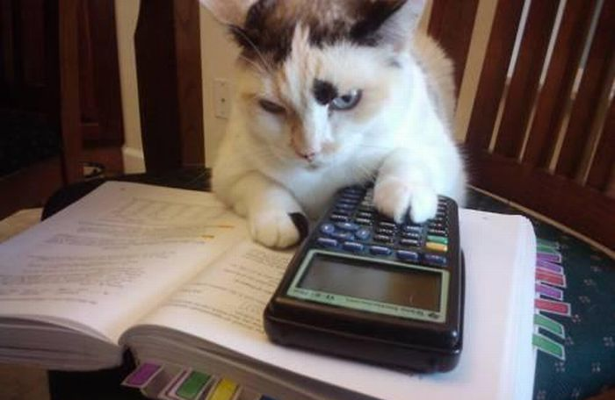
Abacus: Cellular Data Accounting System
LET’S DO
MATH
Notes:
Let’s now talk about abacus, new cellular data accounting system

Slide 22
Abacus: Deterministic DPI (d-DPI)
Byte-by-byte comparison of original vs. retransmitted packets
Buffer size: 2 x Receive Window Size
Accounting process
  Head seq: 0
  Window Size: 2KB
  Next expected seq: 2048
Flow 0
W
W
ACKed
Buffer for new data
Strength:
No false-positive!
Compare for
payload length!
Retransmitted Packet! (Seq = 1024)
Weakness:
Require large memory!
Packet (Src: 102.58.35.5 / Dst: 142.98.7.90)
Notes:
To catch the free-riding attack, Abacus supports DPI with two different modes.
First mode is Deterministic DPI. d-DPI buffers the original TCP segments first. And then when retransmission packet is arrived, d-DPI compare byte-by-byte with original. If there is any disparity, it flags the packet as attack. (In here, W is the receive window size)
This mode has 100% accuracy, but it requires huge memory.

Slide 23

Abacus: Probabilistic DPI (p-DPI)
Store payload by sampling and compare for the sampled data
  E.g., store 5 bytes out of every 1,024-byte → reduce memory by ~200x
Prevent attacker from guessing the sampled byte locations
  Calculate byte location via per-flow key = ${HMAC}_{secret_key}(nonce)$
Base Seq Number (4 byte): 0
0x41 | 0x68 | 0x4C | 0x61 | 0x70
0x71 | 0x69 | 0x62 | 0x54 | 0x5D
0x64 | 0x73 | 0x39 | 0x76 | 0x30
0x7D | 0x5A | 0x42 | 0x4A | 0x62
Per-flow key
[BSN..BSN+1023]
[BSN+1024..BSN+2047]
Offset = SHA1
{Flow Key | BSN}
[BSN+2048..BSN+3071]
[BSN+3072..BSN+4095]
Retransmitted Packet! (Seq = 1024)
Notes:
The second mode of Abacus is Probabilistic DPI, p-DPI.
Unlike d-DPI, it stores the packet data by sampling. For example, if we sample 5 bytes per each 1024-byte packet we can reduce memory requirements about 200 times.
For “free-riding” attack, it doesn’t need to compare all payloads. If defender just finds a part of payload is different, thus, probabilistic detection works well. In next slide, I will show it is reasonable.
In addition, to prevent attacker successful guessing of the sampled byte locations, it randomizes the sampled locations in each entry. This sampled location are determined by using hash function with per-flow key and base sequence number for the entry. This per-flow key is generated by HMAC-secret key.

Slide 24

Abacus: Choosing sampling rate of p-DPI
Choice of n-byte sampling
  Memory space efficiency vs. attack detection accuracy
  For 1000-byte size packet, attack detection probability: $1 − \frac{{{}_{(1000−y)}^{}C}_{x}}{{{}_{1000}^{}C}_{x}}$
Notes:
This graph shows the detection probability of an attack packet as a function of sampling rates.
When p-DPI choose the sampling rate as 0.5%, we can detect the attack with 90% probability if attacker modifies 36.9% of payload.
Attacker would use multiple packets for attack in a flow, we can expect more probability for detection.

Slide 25
Evaluation
Environment setup
  Traffic generator (custom HTTP server) & client
    Dual Intel Xeon E5-2690 CPU (2.90 GHz, 2 octacore)
    64GB RAM
    Intel 10G NIC with 82599 chipsets
  d-DPI Abacus
    Same as traffic generator
  p-DPI Abacus
    Intel i7-3770 CPU (3.40 GHz, quadcore)
    16GB RAM
    Intel 10G NIC with 82599 chipsets
All machines are connected to 10 Gbps Arista 7124 switch
  Abacus monitors all packets via port mirroring
Notes:
This is evaluation setup information.
We use Dual Xeon, 64GB and Intel 10G NIC for traffic generator & client,
and d-DPI is same as above, p-DPI uses less computing power machine.

Slide 26
microbenchmark
d-DPI requires large memory for buffering
  25.9GB @ 160K flows / 53.6GB @ 320K flows
  Begins to drop packets 320K flows
p-DPI requires small memory & CPU
  391MB @ 320K flows
  CPU usage stays under 100% even @ 320K flows
1) d-DPI
2) p-DPI
Notes:
These graph shows the relationship between CPU, Memory Usage and Number of current flows.
Through these graph, we can figure out p-DPI has a good scalability and is practical even on a low-powered machine.

Slide 27

Real Traffic Simulation
Replay 3G cellular traffic logs
  Measured in a commercial cellular ISP in South Korea [Woo’13]
  A daily peak hour: 11PM~12AM on July $7^{th}$, 2012
  61 million flows
  2.79 TB in volume
Inject 100 “free-riding” attacks during replay
Result:
d-DPI & p-DPI accurately detect and report all of the attacks!
Notes:
And we replay 3G cellular traffic logs which is extracted from the real 3G traffic at daily peak hour in the Korea commercial cellular ISP.
As a result, both of d-DPI and p-DPI detect attacks precisely.

Slide 28
Related Works
Peng et. al. [MobiCom’12, CCS’12]
  Toll-free data access attack
    Bypass cellular accounting via DNS port, which used to be free-of-service
    U.S. ISPs now account for all packets going through DNS port
    South Korea ISPs verify DNS packets
  Stealth-spam attack
    Inject large volume of spam data via UDP after the connection is closed
    Attack limited as most of traffic is TCP (95%)
Tu et. al. [MobiSys’13]
  Inject large volume of spam data via UDP while the user is roaming
    Packet drops during handoffs (e.g. 2G ↔ 3G, 3G ↔ LTE)
  Attack not so severe in real life since TCP in most dominant
Notes:
Before this paper, there are some attacks for cellular networks.
Toll-free data access attack
In the past, some ISP doesn’t charge for DNS port, but now, it is blocked.
Stealth-spam attack
Using UDP protocol, it send spam messages after the connection is ended. It has similar effect to usage-inflation attack.
While the user is roaming, handoff (user moves from one network to another) occur, at that time, they can drop lots of packets.

Slide 29
Basic Tunneling Charging
Tunneling Method | SKT | KT | LG U+ | AT&T | Verizon | T-mobile | Direction
ICMP Echo request (phone to Internet) | Not Charged | Not Charged | Not Charged | Charged | Charged | Charged | Up /down
ICMP Echo request (phone to phone) | Blocked | Blocked | Not Charged | Blocked | Blocked | Charged | Up /down
ICMP Unreachable (Internet to phone, TCP) | Not charged but limited | Not Charged | Not Charged | Charged | Blocked | Charged | down
ICMP Unreachable (Internet to phone, UDP) | Not charged but limited | Not Charged | Not Charged | Charged | Blocked | Charged | down
IGMP (phone to Internet) | Not Charged | Blocked | Blocked | - | - | - | up
Syn with payload (phone to Internet) | Not Charged | Not Charged | Not Charged | Charged | Charged | Not Charged | Up /down
Notes:
You can just consider an ICMP packet as a ping packet.
For Korean ISPs, they don’t also charge for these packets. But all American ISPs block these packets.
And IGMP packet is used for requesting join or leave the multicast group.
Syn packet is a kind of control packet. It is used for establishing the connection between client and server.

Slide 30
Conclusion
Massive growth in cellular data usage
  Importance of accurate accounting of cellular traffic
Cellular ISP dilemma
  Should we account for TCP retransmissions packets or not?
  Accounting policies differ between countries
Vulnerabilities in current accounting system
  Usage-inflation attack
  Free-riding attack
Abacus
  Manage 100Ks of concurrent flows with a small memory and CPU usage
  Reliably detect free-riding attack

Slide 31
THANK YOU!

